Slide 1
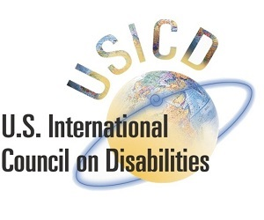
CRPD Article 11 & Disability Inclusive Humanitarian Action
Notes:
Notes to presenter:
This module is entitled “CRPD Article 11 & Disability Inclusive Humanitarian Action.” It is the XX Module in this online learning series.

Slide 2
Key Content and Learning Objectives
This Module discusses disability inclusive humanitarian action and emergency responses within the specific context of the Convention on the Rights of Persons with Disabilities (CRPD). It aims:
To understand the broad context for disability & humanitarian action
To examine the legal basis under the CRPD for disability inclusive humanitarian action
To understand how the CRPD is impacting humanitarian and emergency responses
To identify examples of disability inclusive humanitarian action and emergency responses
Notes:
Notes to presenter:
This Module discusses disability inclusive humanitarian action and emergency responses within the specific context of the Convention on the Rights of Persons with Disabilities (CRPD). It aims:
To understand the broad context for disability & humanitarian action
To examine the legal basis under the CRPD for disability inclusive humanitarian action
To understand how the CRPD is impacting humanitarian and emergency responses
To identify examples of disability inclusive humanitarian action and emergency responses

Slide 3
What is the broad context for disability inclusive humanitarian action & emergency responses?
Notes:
Notes to presenter:
This sub-title slide poses the following question: What is the broad context for disability inclusive humanitarian action & emergency responses?
Persons with disabilities are the largest minority group in the world with the World Health Organization estimating that there are more than one billion people—about 16% of the world’s population—living with some form of disability. Persons with disabilities are also disproportionately impacted by natural disasters, humanitarian crises, and armed conflict, in which they face heightened risk of injury, victimization, and death. This heighten risk to persons with disabilities is due primarily to the lack of consideration of persons with disabilities and their specific protection needs.

Slide 4
Humanitarian Emergencies and Disability
Humanitarian emergencies include: natural disasters (earthquakes, floods, etc.) and war
Persons with disabilities are more at risk of harm and death during humanitarian emergencies than the rest of the population
Article 11 of the CRPD requires States to protect persons with disabilities during humanitarian emergencies
Notes:
Notes to presenter:
Humanitarian emergencies create significant challenges and risks to all people. However, persons with disabilities are likely to be impacted by those challenges and risks, as well as face additionally harm, including death.
This infographic was produced by UN High Commissioner for Human Rights in 2017
Key information share from infographic is:
7 to10% people forcibly displaced due to disasters and war are people with disabilities
75% of persons with disabilities in humanitarian crisis situations report not have sufficient food, water and shelter
50% of people with disabilities in humanitarian crisis situations do not have access to the mobility aids they need
Persons with disabilities are 2 to 4 times more likely to die in humanitarian crisis situations than the rest of the population

Slide 5
Why are persons with disabilities at more risk during war and humanitarian emergencies?
Social, environmental and attitudinal barriers
Discrimination
Abandonment
Inaccessible services and humanitarian aid
Exclusion from emergency planning
Notes:
Notes to presenter:
The impact of natural disasters, humanitarian emergencies and war is greater on persons with disabilities because such events amplify already existing social, environmental and attitudinal barriers that already exist thereby further preventing access to essential services (e.g., healthcare), humanitarian assistance (e.g., emergency shelters) and protection (e.g., police services).
These events also create new barriers for persons with disabilities as essential support services (e.g., medical care, food, water, and electricity) are not longer accessible or operating. Additionally, natural disasters, humanitarian emergencies and war create secondary disabilities for persons already living with a disability as well as increase the number of individuals with newly acquired disabilities, who do not have experience with or understanding of the barriers associated with their impairment.
During natural disasters, humanitarian emergencies and war persons with disabilities are forgotten or purposely left behind or excluded from emergency response efforts. This reality is what places persons with disabilities at higher risk as they are unable to escape the harm and if they are able to do escape they often are not able to access the humanitarian services (e.g., food, shelter, education, water, and medical care) because they are not accessible for persons with disabilities.
In many instances, persons with disabilities are forced to leave their assistive devices behind in order to escape harm because evacuation planning did not consider how to appropriately evacuate persons with disabilities. This leave persons with disabilities reliant on family and strangers to navigate refugee and emergency camps.
These factors that increase the risk of harm to persons with disability are very much rooted in the lack of inclusion of and consultation with persons with disabilities and their representative organization when developing, implementing, and rebuilding after disasters, humanitarian emergencies and war.

Slide 6
What is the legal basis under the CRPD for disability inclusive humanitarian action?
Notes:
Notes to presenter:
This sub-title slide poses the following question: What is the legal basis under the CRPD for disability inclusive humanitarian action?
The UN CRPD is a unique treaty because it contains an article that requires States to ensure that their responses to natural disasters, humanitarian crises, and armed conflict include specific protections for persons with disabilities, consider the specific needs of persons with disabilities, and ensure that the rights and privileges outlined in the CRPD are upheld during times of emergency.

Slide 7
Article 11 of the UN CRPD
Article 11, Situations of Risk and Humanitarian Emergencies:
States Parties shall take, in accordance with their obligations under international law, including international humanitarian law and international human rights law, all necessary measures to ensure the protection and safety of persons with disabilities in situations of risk, including situations of armed conflict, humanitarian emergencies and the occurrence of natural disasters.
Video Viewing: What is the UN CRPD?
KEY POINT: Article 11 of the UN CRPD requires countries to protect persons with disabilities in situations of risk
Notes:
Notes to presenter:
Play the video entitled “What is the UN CRPD.” This an easy-to-understand video describing what the UN CRPD is and its importance to persons with disabilities.
The UN CRPD is a unique human rights treaty because it contains Article 11, which does not allow for countries to suspend the rights or protections for persons with disabilities found within the UN CRPD during times of humanitarian emergencies, including war. Additionally, Article 11 requires that countries created, reform, and implement emergency response plans that consider the needs of, are accessible to, and developed with the help of persons with disabilities and/ or organizations of persons with disabilities.

Slide 8
How to Comply with Article 11 of the UN CRPD in Humanitarian Emergencies?
reform policies and practices in the context of situations of risk and humanitarian emergencies under the CRPD;
ensure effective management and dissemination of accessible information at all stages of emergencies;
ensure active coordination, participation and meaningful consultation with persons with disabilities and their representative organizations, including women, boys and girls with disabilities, at all levels;
mobilize adequate, timely and predictable resources to operationalize their commitment for emergency preparedness and response that is inclusive of and accessible to persons with disabilities following a human rights-based approach in their programming efforts, in order to avoid excluding members of this group;
build capacity across stakeholders, including both military and civilian, peacekeeping personnel, and other field workers intervening in emergency situations regarding the rights of persons with disabilities;
implement international cooperation in line with the standards established in the CRPD;
avoid including in their disability-related strategies matters of prevention of primary impairments;
promote the inclusion of persons with disabilities in existing frameworks dealing with conflict and emergency situations;
adopt internationally agreed guidelines on humanitarian response for upholding the rights of persons with disabilities.
Notes:
Notes to presenter:
In 2015, the UN Office of the High Commissioner for Human Rights published a report on Article 11 of the UN CRPD that explained the obligations of countries in protecting persons with disabilities. As part of the report, the UN Office of the High Commissioner for Human Rights found that Article 11 of the CRPD requires countries to apply the human rights found in the UN CRPD during times of emergencies, including war. To accomplish this, countries need to make changes to their policies and practices to include and address the needs of persons with disabilities. This can be done in a number of ways, which are listed on the slide above.
Highlights to point out:
Countries need to make sure that information regarding the emergency is provided in an accessible format for all persons with disabilities for the duration of the crisis.
Persons with disabilities must be coordinated and consulted with, including through their representative organizations, in preparation for, during and after an emergency to ensure their needs and rights are being protected.
When responding to a humanitarian emergency ensure that the resources and response are inclusive of persons with disabilities and respect their human rights to avoid excluding members of the disability community
Work to improve the capacity for those organizations and individuals who respond to emergencies—like military and civilian organizations, peacekeepers, and fieldworkers—to make sure they understand the specific needs of persons with disabilities in a humanitarian crisis.
Promote the inclusion of persons with disabilities into already existing emergency response planning.

Slide 9
Article 32 of the CRPD
Article 32, International Cooperation
States Parties recognize the importance of international cooperation and its promotion, in support of national efforts for the realization of the purpose and objectives of the present Convention, and will undertake appropriate and effective measures in this regard, between and among States and, as appropriate, in partnership with relevant international and regional organizations and civil society, in particular organizations of persons with disabilities.
Such measures could include:
a) Ensuring that international cooperation, including international development programmes, is inclusive of and accessible to persons with disabilities;
b) Facilitating and supporting capacity-building, including through the exchange and sharing of information, experiences, training programmes and best practices;
c) Facilitating cooperation in research and access to scientific and technical knowledge;
d) Providing, as appropriate, technical and economic assistance, including by facilitating access to and sharing of accessible and assistive technologies, and through the transfer of technologies.
Notes:
Notes to presenter:
Article 32 of the CRPD is an important aspect of ensuring full compliance with Article 11. Article 32 requires that States, donors, international organizations, and non-governmental organizations ensure that their development programing and humanitarian assistance is fully inclusive and accessible for persons with disabilities. This means that in responding to man-made or natural disasters States must ensure that their funding and programming is inclusive of persons with disabilities to comply with Article 11 and Article 32 obligations. Building on the responsibilities of Article 11, Article 32 makes clear that the responsibility for inclusion of persons with disabilities during times of crisis, aftermath, and rebuilding is the responsibility of not simply the effected State but also those countries and organizations providing development programming and humanitarian aid. In practical terms, State Parties must ensure that their funding for and implementation of development and humanitarian programs are inclusive of persons with disabilities. For donor countries this means that all their development programming and humanitarian assistance must be inclusive. For recipient countries, this means that all the development programming and humanitarian aid being provided to help the effective country is inclusive of persons with disabilities.

Slide 10
UN Security Council Resolution 2475 (2019)
Notes:
Notes to presenter:
Recognizing the obligation created by Article 11 of the UN CRPD, the international community has taken steps to better protect persons with disabilities when taking humanitarian action in response to emergencies and war.
One of the more important steps that has been taken occurred on 20 June 2019, when the UN Security Council unanimously passed historic Resolution 2475, which was the first time that the UN Security Council officially recognized the needs of persons with disabilities in situations of risk, including war. Notably, Resolution 2475 encouraged all UN Member States to ensure that persons with disabilities have equal access to basic services, including education, health care, transportation, and information during times of humanitarian emergencies. Also, importantly Resolution 2475 urged all UN Member States to enable meaningful participation and representation of persons with disabilities, including their representatives organizations, in humanitarian action and to consult with those who have expertise working on disability mainstreaming.

Slide 11
What is the impact of Article 11 of the CRPD on humanitarian and emergency responses?
Notes:
Notes to presenter:
This sub-title slide poses the following question: What is the impact of Article 11 of the CRPD on humanitarian and emergency responses?
The UN CRPD is a unique treaty because it contains an article that requires States to ensure that their responses to natural disasters, humanitarian crises, and armed conflict include specific protections for persons with disabilities, consider the specific needs of persons with disabilities, and ensure that the rights and privileges outlined in the CRPD are upheld during times of emergency.

Slide 12
CRPD Committee Statements on Article 11
In Concluding Observations the CRPD Committee has recommended to States, in accordance with the Sendai Framework for Disaster Risk Reduction 2015-2030, to take the following actions to comply with the obligations of Article 11:
Adopt and develop comprehensive strategies and protocols for general emergency risk situations
Ensure effective involvement of organizations of persons with disabilities in disaster risk reduction strategies and national disaster management plans to ensure accessibility and inclusion
Use of a human rights-based response for international displaced persons with disabilities, especially those displaced for prolonged periods of times in all situations of risk, including violence during armed conflict and natural disasters
Develop early warning systems in situations of risk that are accessible for all persons with disabilities
Conduct vulnerability assessments of persons with disabilities, specifically child with disabilities, who are asylum seekers and persons in refugee-like situations, to ensure they have access to social, protection, assistance technologies, information and adequate services (e.g. shelter, medical care, sanitation, etc.)
Notes:
Notes to presenter:
The CRPD is the body of independent experts which monitors implementation of the Convention by the States Parties. All States parties are obliged to submit regular reports to the Committee on how the rights are being implemented. States must report initially within two years of accepting the Convention and thereafter every four years. The Committee examines each report and shall make such suggestions and general recommendations on the report as it may consider appropriate and shall forward these to the State Party concerned. The Optional Protocol to the Convention gives the Committee competence to examine individual complaints with regard to alleged violations of the Convention by States parties to the Protocol.
Concluding observations are recommendations and evaluations based on reports by States to the CRPD Committee regarding their implementation of obligations under the treaty. The above recommendation were summarized from CRPD Concluding remarks made to India, Greece, and Niger.
The CRPD Committee has also, in General Comment No. 6, discussed the linkage between the principle of non-discrimination and Article 11, while also mentioning international humanitarian law (law of war) and the obligation that States have to protect persons with disabilities by drawing a link between the international humanitarian law principle of distinction and the CRPD non-discrimination framework. Essentially, the CRPD Committee reaffirmed that that both the CRPD and international humanitarian law require protection of persons with disabilities and also their full and equal access to aid and services during war and natural disaster.

Slide 13
UN Sustainable Development Goals
SDG 10 – Reduced Inequalities
SDG 11 – Sustainable Cities & Communities
SDG 16 – Peace, Justice and Strong Institutions
Notes:
Notes to presenter:
The requirement to protect and include persons with disabilities in the preparing for, responding to, and rebuilding after a humanitarian emergencies established by CPRD Article 11 has been adopted by and incorporated into the UN Sustainable Development Goals (SDGs) which were adopted by the UN Member 2015. In 2018, a report published by the UN Department of Economic and Social Affairs highlighted all the ways by which to include persons with disabilities into each of the UN SDGs.
You can click on the links for the relevant SDGs to take them to the websites for each on the right side of the slide.
SDG 10 focuses on the reduction of inequality within and among countries. What this means for disability is that countries must promote the social, economic, and political inclusion of all people, irrespective of disability. Additionally, it requires the elimination of discriminatory laws, policies, and practices concerning persons with disabilities. It is important to recognize that some persons with disabilities are at an even higher disadvantage than other due to others because of multiple discrimination. Some examples are women with disabilities, indigenous persons with disabilities, and persons with intellectual and psychosocial disabilities.
SDG 11 focuses on building and upgrading cities and human settlements to be inclusive, safe, resilient, and sustainable. What this means for disabilities is that cities and settlement must be accessible for all to have access to adequate, safe, and affordable housing and basic services. Additionally, it calls for safe, affordable, accessible, and sustainable transportation systems for all with specific attention given to the needs of all persons with disabilities. Lastly it seeks to have urbanization be inclusive by allowing universal access to safe, inclusive and accessible green and public spaces with specific attention given to the needs of all persons with disabilities.
SDG 16 focuses on reducing all forms of violence, ensuring access to justice for all, building effective, accountable, and inclusive institutions, and ensuring responsive, inclusive, accountable and representative decision-making to leave no one behind. What this means for disabilities is that countries must reduce the exposure of persons with disabilities to violence, providing access to justice, making public institutions accountable and transparent, making participation in the public decision-making process inclusive,, and enhancing access to information. Importantly, SDG 16 works together with SDG 10 as it is necessary to removed discriminatory laws and policies to allow for the inclusion and consideration of persons with disabilities.
Each one of these SDGs works towards the fulfillment of the requirement established by Article 11 of the CRPD, which is to protect and include persons with disabilities in the preparing for, responding to, and rebuilding after a humanitarian emergencies.

Slide 14
IASC Guidelines
Sendai Framework
Humanitarian Disability Charter
Notes:
Notes to presenter:
In July 2019, the UN Inter-Agency Standing Committee (IASC) published the first-ever guidelines on how to effectively identify and respond to the needs and rights of persons with disabilities during humanitarian emergencies, such as natural disasters and war. These guidelines were developed with and by persons with disabilities and their representative organizations. There are four main objectives of these guidelines: 1) provide practical guidance on including persons with disabilities in humanitarian programming and coordination, 2) increase capacity among humanitarian stakeholders to develop and implement quality programs that are inclusive of persons with disabilities, 3) describe the roles and responsibilities of humanitarian stakeholders to include persons with disabilities in humanitarian action, 4) increase and improve the participation of persons with disability and organizations of persons with disabilities (OPDs) in preparedness, response and recovery.
The Sendai Framework was endorsed and adopted by UN Members States in March 2018 with the goal of providing a framework for how countries can take meaningful action to protect against the harm and risks of both natural and man-made disasters. Sendai is the first major agreement of the 2030 Agenda for Sustainable Development that was mentioned in the previous slide. The Sendai Framework advocates for “the substantial reduction of disaster risk and losses in lives, livelihoods and health and in the economic, physical, social, cultural and environmental assets of persons, businesses, communities and countries.” There are four priorities of the Sendai Framework: 1) understanding disaster risk in all it dimensions of vulnerability, capacity, exposure of persons and assets, hazard characteristics and the environment, 2) strengthen disaster risk governance to manage disaster risk, 3) invest in disaster risk reduction for resilience, and 4) enhance disaster preparedness for effective response and to “Build Back Better” in recovery, rehabilitation and reconstruction.
In May 2016, the Charter on Inclusion of Persons with Disabilities in Humanitarian Action was developed by over 70 statesholders including countries, UN agencies, international civil society, and regional and national organizations of persons with disabilities. Although not legally binding treaty, organizations and countries that have endorsed the Charter commit to make humanitarian action inclusive of persons with disabilities, by lifting barriers faced by persons with disabilities in accessing relief, protection and recovery support and ensure the participation of persons with disabilities in the development, planning and implementation of humanitarian programs.

Slide 15
CRPD Committee Reporting
State Parties Reports
Civil Society
The CRPD requires States Parties to submit a report to the CRPD Committee two years after ratification of the treaty
State Parties are also required every subsequent four years to submit a report to the CRPD Committee
Civil society, specifically organizations of persons with disabilities, are encouraged to submit alternative reports (“shadow reports”) to the CRPD committee
National Human Rights Institutions or the Office of the Disability Ombudsman are also encouraged to submit alternative reports
Notes:
Notes to presenter:
State Parties, meaning both donor and recipient countries, have an obligation to ensure that all Articles of the CRPD are implemented correctly, including Article 11 and Article 32. This reporting requirement and ability for civil society to draft shadow reports is exceptionally important in particular with regard to Article 11 as it is an area that so far has been overlooked by State Party reports to the CRPD Committee. Additionally, given the interplay between Article 11 and Article 32 it is also essential that more robust and detailed reporting be done by State Parties as well as civil society on the implementation of both Article 11 and 32.
Reports from civil society provide the CRPD with a very important tool in verifying good practice and identify gaps in the implementation of Article 11 as well as Article 32. Organizations like the OHCHR and the International Disability (IDA) have provided advice to State Parties and civil society on how to develop reports to the CRPD Committee. Generally the guidance typically recommends that reports examine and provide information on the implementation of all CRPD articles, including Article 32.

Slide 16
What are some examples of disability inclusive humanitarian action?
Notes:
Notes to presenter:
This sub-title slide poses the following question: What are some examples of disability inclusive humanitarian action?
With all of above requirements, guidelines, and rules we will explore how they are put into practice to accomplish the goal of Article 11 of the CRPD and ensure the inclusion of persons with disabilities in humanitarian action.

Slide 17
Inclusion in Disaster Risk Reduction & Preparedness
Lessons Learned
Persons with disabilities and organizations of persons with disabilities (OPDs) can have a crucial role to play in disaster risk reduction and preparedness
Partnerships between humanitarian actors and OPDs are crucial to build OPD’s capacity to act as first responders
A person-center and community approach to allow for engagement between OPDs, the community, and government to participate in decision-making is essential
Humanitarian actors need to take deliberate action to prepare themselves to address the particular challenges faced by persons with disabilities in a crises
Accessibility and reasonable accommodation is a requirement for meaningful participation and access to services
The disability community is diverse and different disability groups need to be considered and represented
Notes:
Notes to presenter:
Pre-crisis actions to mitigate, prevent and prepare for crises have a much greater impact on the protection of at-risk populations than actions during response and recovery. However, persons with disabilities are routinely excluded from disaster risk reduction (DRR) and preparedness programs. In case of emergency, governments, humanitarian actors and persons with disabilities themselves end up often being inadequately prepared.
A case study was conducted in 2019 to identify best practices in the inclusion of persons with disabilities in humanitarian settings, including the delivery of assistance and protection efforts in both natural and man-made disasters. With efforts to include persons with disabilities accelerating it was essential to have best practices that embody the purpose of the CRPD and specifically Article 11.
These are some of the lessons learned from the study:
»Persons with disabilities and OPDs can have a critical role to play in DRR and preparedness, for example in contingency planning; early-warning systems simulations; collection of censuses and household data disaggregated by disability; training; and as local civil society partners. OPDs often have established networks, and the ability to identify and communicate with at-risk populations and understand the barriers faced by persons with disabilities.
»Partnerships between humanitarian actors and OPDs on DRR and preparedness are crucial to build OPDs’ capacity to act as first responders. This requires long-term approaches to build trust and collaborative working relationships among OPDs, humanitarian organizations and local governments.
»DRR and preparedness practices that apply a person-centered and community approach facilitate the engagement between OPDs, the community and governments, and contribute to the participation of persons with disabilities in decision-making in disaster risk management and in their own communities. Such practices can lead to positive outcomes for persons with disabilities, such as increased visibility and influence; reduction in exposure to hazards; heightened resilience and reduced stigma and discrimination. The outcome of these practices may be enhanced if they include activities aiming to remove economic barriers and include psychosocial support.
»Humanitarian actors need to take deliberate actions to prepare themselves to address the particular challenges faced by persons with disabilities when the crisis strikes. This could be done by joining forces with persons with disabilities, OPDs and technical experts through training and partnerships.
»Accessibility and reasonable accommodation 23 are preconditions to ensure meaningful participation of and access to services by persons with disabilities. This means considering accessibility in all aspects of humanitarian interventions and planning adjustments, including through appropriate budget, to enable equal access of persons with disabilities, such as transportation, sign-language interpretation, or assistive devices.
»The different disability groups need to be considered. Organizations should be mindful of promoting diverse representation within OPDs and also seek to work with OPDs who represent persons with disabilities whose perspectives are less often considered, such as persons with intellectual disabilities. Should this not be possible, a variety of persons with a diverse range of disabilities can be involved.

Slide 18
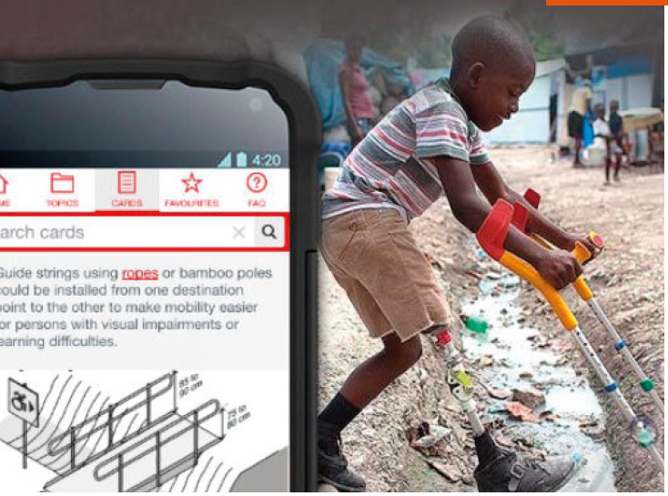
Bangladesh
Providing technical support to address barriers for persons with disabilities
Practice: A mobile application was used to provide simple, one-page guidance on all issues relevant to the design and implementation of inclusive humanitarian action
Challenge: The application was not translated into the local language making it hard to share inclusive designs with local staff, and the lack of images or drawing to clarify concepts to overcome the language barrier
Solution: Technical resources like the mobile application should be translated into the local language, include images, and be combined with basic training on inclusion of persons with disabilities as well as follow up support for users of the resource
Notes:
Notes to presenter:
Case study: INGOs receive technical support to address barriers to persons with disabilities, examples from different sectors
Transversal: mobile application provides guidance to humanitarian workers in the field
PRACTICE.
In 2017, Christian Blind Mission (CBM) developed a mobile application, the Humanitarian Hands-on Tool 50 (HHoT), which provides simple, one-page guidance on all issues relevant to the design and implementation of inclusive humanitarian action. The “task cards” in the app are fully searchable and logically interlinked for ease of use, and can be shared, printed or saved as favorites. The whole app can be downloaded to any mobile device and is then available without internet or mobile connection. The HHoT has been field-tested in both Bangladesh and Kenya, where training on the app and follow-up sessions were provided to CBM’s partners.
OVERCOMING CHALLENGES.
Users of the app repeatedly expressed interest in having the information translated into local languages to ease the work of local staff. As such, CBM has already translated the app into Spanish, and is working on translation into Bahasa. Related to this, users reported that the presence of images and drawings helped to clarify concepts, especially when language is a barrier.
KEY LESSON.
Technical resources like CBM’s HHoT app are most successful when they are available in the local languages, utilize images, and are combined with basic training on inclusion of persons with disabilities as well as follow-up technical support for users of the tools.

Slide 19
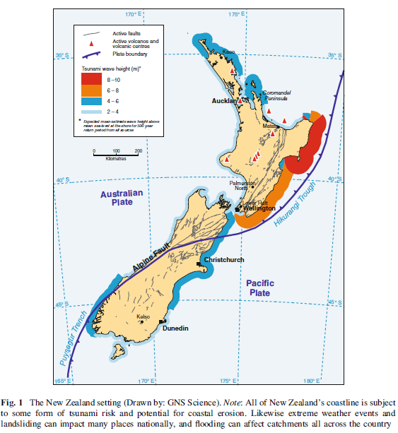
New Zealand
Persons with intellectual disabilities lead preparedness program
Practice: After a 2011 earthquake in New Zealand, workshops on disaster preparedness were co-developed and co-delivered across New Zealand to persons with intellectual disabilities and their supporters
Challenge: These workshops soon after a disaster can trigger re-experiencing of the trauma, requiring professional and personal support to address ongoing emotional challenges
Key Lesson: A genuine co-design approach allows persons with disabilities to be active agents in disaster preparedness, provides a safe space, and ensures accessible communication
Notes:
Notes to presenter:
Persons with intellectual disabilities lead preparedness program, New Zealand
PRACTICE.
In 2011, in response to the earthquake that hit Christchurch, New Zealand, the OPD IHC, co-developed and co-delivered a series of workshops on disaster preparedness with persons with intellectual disabilities from a local self-advocacy group. The workshops were delivered to persons with intellectual disability and their supporters across New Zealand.
IHC supported the self-advocacy group to form an Earthquake Reflection Group to develop survival strategies and compile kits with essential items for future disasters. The group also established relationships with key stakeholders such as Christchurch City Council, New Zealand Red Cross, and Christchurch Earthquake Recovery Association (CERA), which ensured they had a say in the rebuilding of the city.
OVERCOMING CHALLENGES.
Discussing preparedness soon after a disaster can trigger the re-experiencing of trauma. IHC made every effort to ensure people accessed professional and personal support to deal with ongoing emotional challenges.
KEY LESSON.
Persons with intellectual disabilities can be active agents in disaster preparedness. This requires a genuine co-design approach, providing a safe space and ensuring accessible communication (such as easy-read or illustration) for persons with intellectual disabilities to tell their stories and take a leadership role.

Slide 20
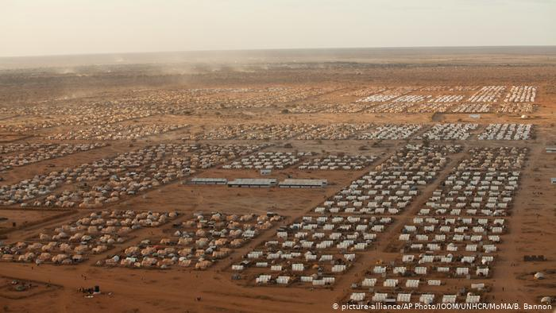
Kenya
Disability inclusion committees conduct assessment in refugee camps
Practice: Since 2014, persons with disabilities have participated in assessment of barriers and enablers to access essential services in two refugee camps in Kenya. The findings are presented to the agencies responsible for those services
Challenge: Negative attitudes and stereotypes of persons with disabilities meant that they were excluded from certain humanitarian aid distribution points and not considered by refugee camp administrators in activities
Key Lesson: Building capacity of persons with disabilities to represent themselves in decision-making structures will allow them to participate in training, monitoring and coordination meetings to increase the impact of advocacy for inclusion and accessibility
Notes:
Notes to presenter:
Disability Inclusion Committees conduct assessments in refugee camps, Kenya
PRACTICE.
Since 2014, Handicap International (HI) supports persons with disabilities to participate in assessments of barriers and enablers to access essential services in Kakuma and Dadaab refugee camps in Kenya. The assessments are conducted with Disability Inclusion Committees of persons with disabilities and caregivers who, during focus-group discussions and observational visits, give their insights on barriers to identification, physical accessibility, information and communication, meaningful participation, as well as measures for reasonable accommodation.
The findings are presented by the committee members to the agencies responsible for each sector in specific coordination meetings and are used to raise attention to barriers in community meetings. In parallel, HI conducts training and coaching for humanitarian agencies to adapt their approaches. The resulting changes include allowing alternative food collectors at distributions; prioritization of persons with disabilities at repatriation desks; the construction of accessible toilets; and the recruitment of secondary-school teachers with experience of inclusive education. Furthermore, in Kakuma camp, four members of the Disability Inclusion Committees have been elected as representatives in the zonal governance structure established by the camp administration.
OVERCOMING CHALLENGES.
Before the establishment of these committees, the perspectives of persons with disabilities were not considered by the camp management actors and service providers. Persons with disabilities were perceived as beggars and often not allowed to enter certain distribution points.
It has been a challenge for HI to support the empowerment of persons with intellectual disabilities to directly participate in the activities of the Disability Inclusion Committee, as they are usually represented by parents. Together with the committee members, HI is attempting to overcome attitudinal barriers through sensitization of the wider community on the rights and capacities of all persons with disabilities.
KEY LESSON.
In some cases, capacity building may be an essential component for persons with disabilities to be able to represent themselves in decision-making structures. The participation of persons with disabilities in training, monitoring and coordination meetings increases the impact of advocacy around accessibility and inclusion.

Slide 21
Summary
Persons with disabilities are more at risk of harm and death during humanitarian emergencies than the rest of the population because of:
Social, environmental and attitudinal barriers
Discrimination
Abandonment
Inaccessible services and humanitarian aid
Exclusion from emergency planning
Article 11 of the CRPD requires States to protect persons with disabilities during humanitarian emergencies
Persons with disabilities and OPDs can have a critical role to play in disaster risk reduction and preparedness
Notes:
Notes to presenter:
Persons with disabilities are more at risk during situations of humanitarian emergencies (including natural and man-made disasters). This higher risk is because of social, environmental and attitudinal barriers, discrimination, abandonment, inaccessible services and humanitarian aid, and exclusion from emergency planning.
Article 11 of the CRPD requires States to protect persons with disabilities during humanitarian emergencies. This requirement was reinforced by the UN Security Council Resolution 2475 (2019). There are a number of frameworks that now exist to allow for the inclusion and consideration of persons with disabilities in disaster risk reduction and humanitarian action. Currently, there is an effort internationally to properly make humanitarian action inclusive of persons with disabilities. Additionally, there are a number of good practices have emerged on how to do be inclusive and empower persons with disabilities although much more needs to be done.
It is important to remember and advocate for persons with disabilities and OPDs to play a critical role to play in disaster risk reduction and preparedness.

Slide 22
Additional Resources
Case Study Collection 2019: Inclusion of persons with disabilities in humanitarian action (2019), https://www.internationaldisabilityalliance.org/blog/case-studies-collection-2019-inclusion-persons-disabilities-humanitarian-action
Inter-Agency Standing Committee, IASC Guidelines, Inclusion of Persons with Disabilities in Humanitarian Action (2019), https://interagencystandingcommittee.org/iasc-task-team-inclusion-persons-disabilities-humanitarian-action/documents/iasc-guidelines
U.N. Office of Disaster Risk Reduction, Sendai Framework for Disaster Risk Reduction 2015-2030 (2015), https://www.undrr.org/publication/sendai-framework-disaster-risk-reduction-2015-2030
Inter-Agency Standing Committee, IASC Guidelines for Mental Health and Psychosocial Support in Emergency Settings (2007), https://interagencystandingcommittee.org/iasc-reference-group-on-mental-health-and-psychosocial-support-in-emergency-settings
World Humanitarian Summit, Charter on Inclusion of Persons with Disabilities in Humanitarian Action (2016), https://humanitariandisabilitycharter.org/the-charter/

