Slide 1


Disability Inclusive Development
Monitoring Disability Inclusive Development and other CRPD Obligations
Notes:
This module is entitled “Monitoring Disability Inclusive Development and other CRPD Obligations.” It is part of the online learning series brought to you by the US International Council on Disabilities with the generous support of Rehabilitation International.

Slide 2
Topics to be Covered
What is monitoring and how does it relate to Article 32?
What is the obligation to report?
What is the CRPD Reporting Cycle?
What are OPD Roles and Responsibilities in this process?
Notes:
Like other modules in this learning series, there are specific learning objectives and topics to be covered. We seek to answer the following key questions:
What is monitoring and how does it relate to Article 32?
What is the obligation to report?
What is the CRPD Reporting Cycle
OPD Roles and Responsibilities

Slide 3
CRPD Monitoring – What is Monitoring?
Checking or tracking to see whether a State is meeting its CRPD obligations
  Is the State complying or not? If not, why not? What can it do better? What steps can it take to improve?
  Monitoring Article 32 of the CRPD might entail addressing whether a country is ensuring that its development programs are inclusive of persons with disabilities – for a donor nation, are their programs in other countries accessible? For recipients of development assistance, is the country ensuring that its development programs are accessible to persons with disabilities?
3
Notes:
This slide considers what we mean by CRPD monitoring and how it relates to Article 32. Put simply, monitoring means checking or tracking to see whether a State is meeting its CRPD obligations. It involves asking the following questions:
Is the State complying or not? If not, why not? What can it do better? What steps can it take to improve?
Monitoring Article 32 of the CRPD might entail addressing whether a country is ensuring that its development programs are inclusive of persons with disabilities – for a donor nation, are their programs in other countries accessible? For recipients of development assistance, is the country ensuring that its development programs are accessible to persons with disabilities?

Slide 4
Consider: Who Monitors a Human Rights Treaty?
Notes:
Let us now turn to the consideration of who exactly monitors human rights treaties? Think about the key actors who might be involved in monitoring implementation of the CRPD, especially in relation to its Article 32 obligations.

Slide 5
Many stakeholders monitor human rights conventions
States
OPDs
Other civil society organizations
National Human Rights Commissions, Ombuds Persons
UN mechanisms, including treaty bodies
Others?
Notes:
A wide range of actors monitors human rights conventions – States are obligated to monitoring their own implementation of treaty obligations. There are also important roles for national human rights institutions, for civil society organizations such as OPDs, for UN mechanisms among others.

Slide 6
Reporting Obligation Established by Article 35
Each State Party must submit a comprehensive report on measures taken to implement the CRPD within 2 years of ratification, then every 4 years.
Recall that the European Union, as a ratifying regional integration organization, is also part of monitoring its own implementation of the CRPD – critical given that it is one of the largest donors for international cooperation programs.
Notes:
Under Article 35 of the CRPD, States must participate in the filing of reports to the CRPD Committee. The reporting duty starts within 2 years of a State Party’s ratification, and then follows a four year reporting cycle. The European Union is party to the CRPD as a regional integration organization. It too must participate in the reporting process. This is important given its outsize role as a donor of international cooperation programs.

Slide 7
OPD Roles - Article 4.3
General Obligations
In the development and implementation of legislation and policies to implement the present Convention, and in other decision-making processes concerning issues relating to persons with disabilities, States Parties shall closely consult with and actively involve persons with disabilities, including children with disabilities, through their representative organizations.
Notes:
Article 4(3) of the CRPD sets out the far reaching obligation among States to consult with OPDs on all issues of implementation. This too is an element of monitoring in that States must engage OPDs in that process.

Slide 8
OPD Roles - Article 33(3) Monitoring
3. Civil society, in particular persons with disabilities and their representative organizations, shall be involved and participate fully in the monitoring process.
Notes:
OPDs and civil society are given a specific role in monitoring under Article 33 of the CRPD.

Slide 9

CRPD Monitoring and Implementation - International Mechanisms
Conference of States Parties
Meets in order to consider any matter with regard to the implementation of the Convention (biennially or upon decision by the Conference)
Committee on the Rights of Persons with Disabilities
a body of independent experts serving in their personal capacity
tasked with reviewing States’ implementation of the Convention
initially comprises 12 independent experts; rises to 18 members after an additional 60 ratifications or accessions to the Convention
Optional Protocol to the CRPD
A legally binding treaty separate from the CRPD that States may opt into in order to grant the CRPD Committee additional mandates:
1) Review of individual/group communications alleging violations of the CRPD and resulting in Committee recommendations to a State;
2) Procedure of inquiry allowing the CRPD Committee to review grave and systemic violations of the CRPD in a particular country
Notes:
This slide provides a very brief summary of the CRPD Monitoring and Implementation measures on the international level. These include the following three elements of the CRPD’s international monitoring mechanism:
Conference of States Parties
Meets in order to consider any matter with regard to the implementation of the Convention – since the adoption of the CRPD< the Conference has met annually in New York.
Committee on the Rights of Persons with Disabilities
A body of independent experts serving in their personal capacity tasked with reviewing States’ implementation of the Convention Initially the Committee comprised 12 independent experts; it rose to 18 members after an additional 60 ratifications or accessions to the Convention
Optional Protocol to the CRPD
A legally binding treaty separate from the CRPD that States may opt into in order to grant the CRPD Committee additional mandates. 1) Review of individual/group communications alleging violations of the CRPD and resulting in Committee recommendations to a State; 2) Procedure of inquiry allowing the CRPD Committee to review grave and systemic violations of the CRPD in a particular country

Slide 10

Monitoring and Implementation - National Level
National focal points & coordination mechanisms within government
Implementation focal point in government
Coordination focal point
National Human Rights Institutions (NHRIs) play independent monitoring role
Civil society plays monitoring role
Notes:
This slide provides national level Monitoring and Implementation measures.
-National Level
National focal points & coordination mechanisms within government
Implementation focal point within government
Coordination focal point
National Human Rights Institutions (NHRIs) play important role
Civil society role in monitoring

Slide 11
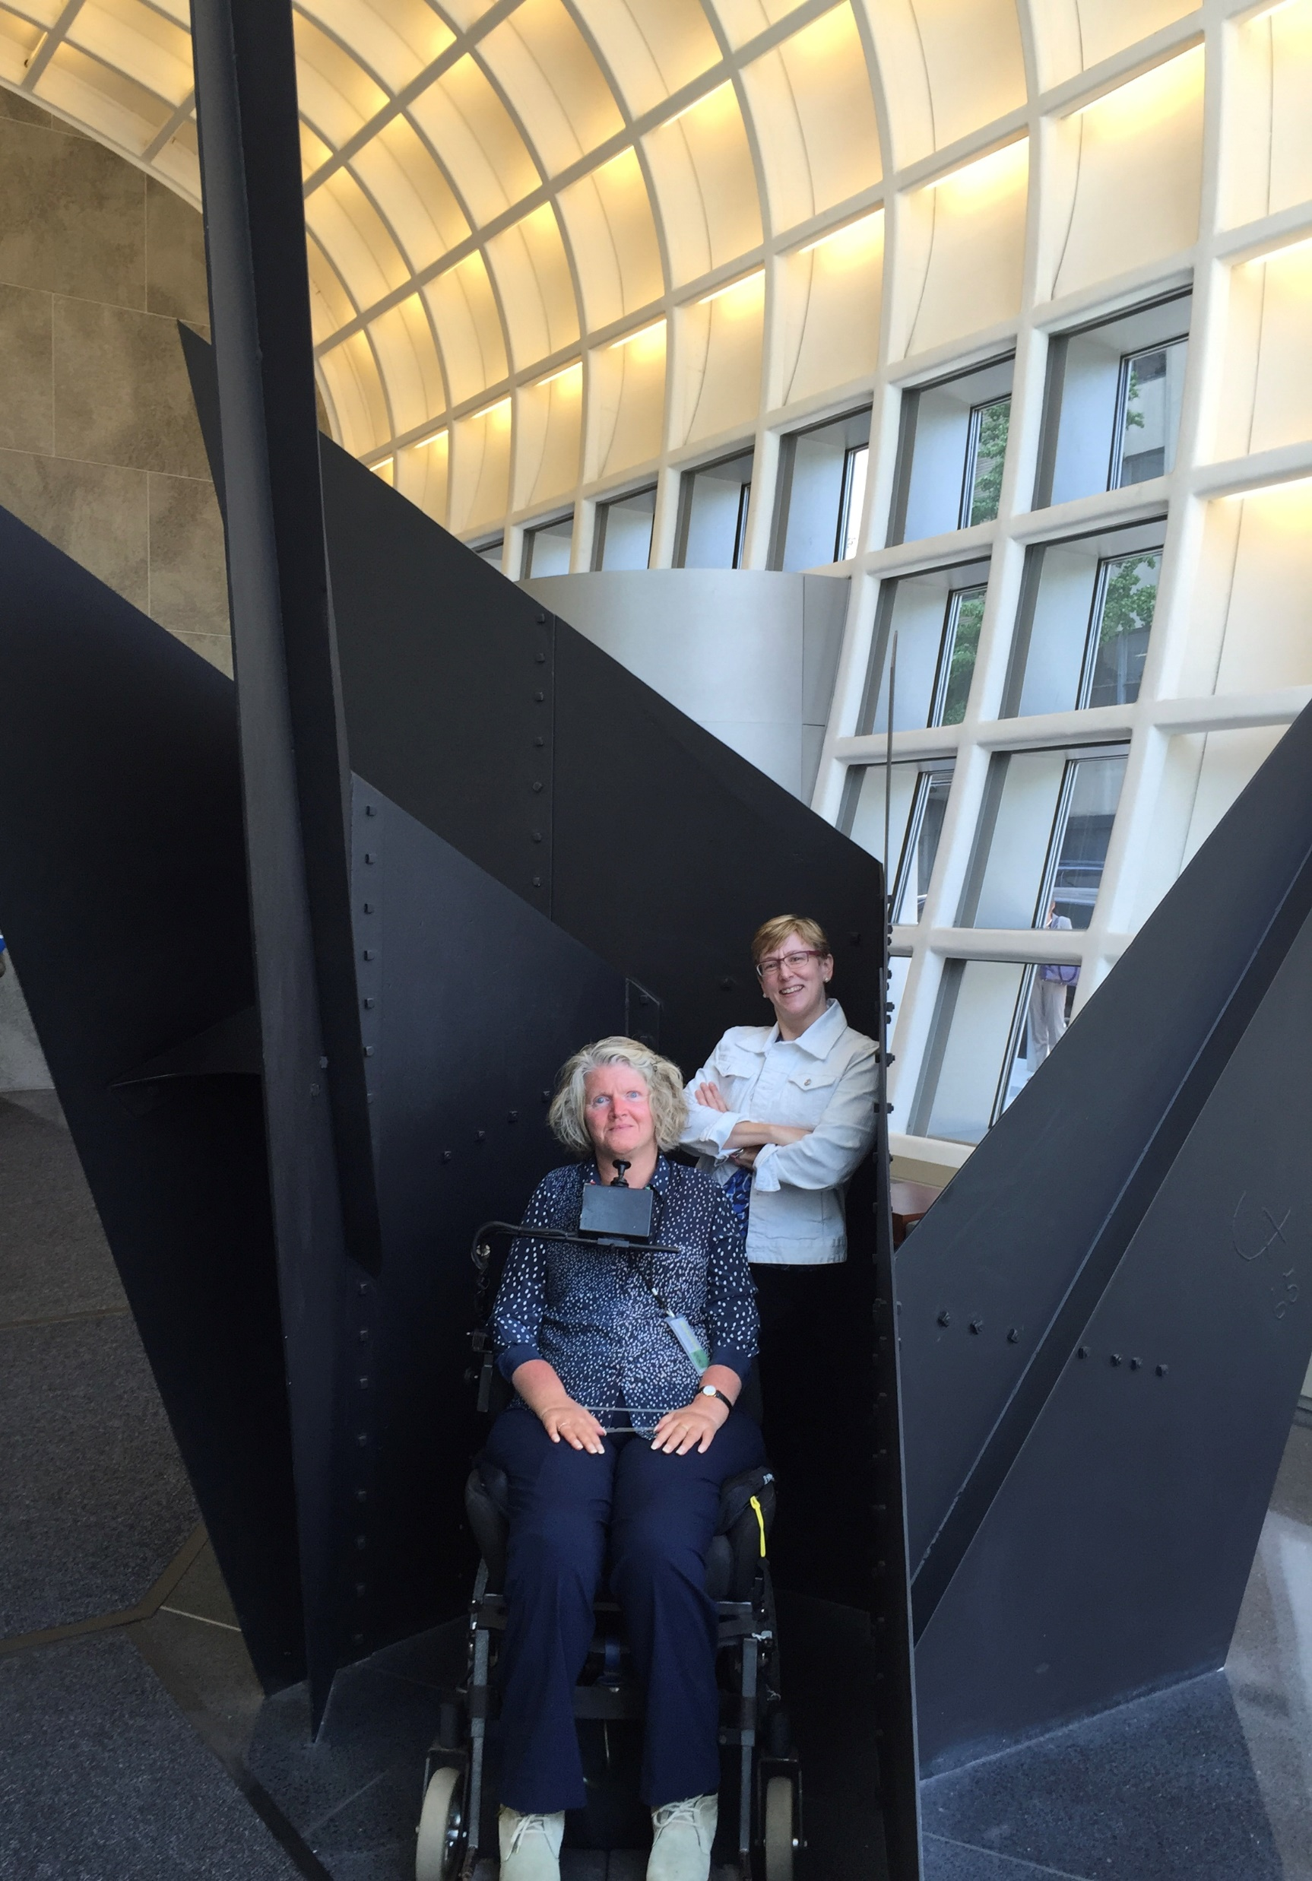
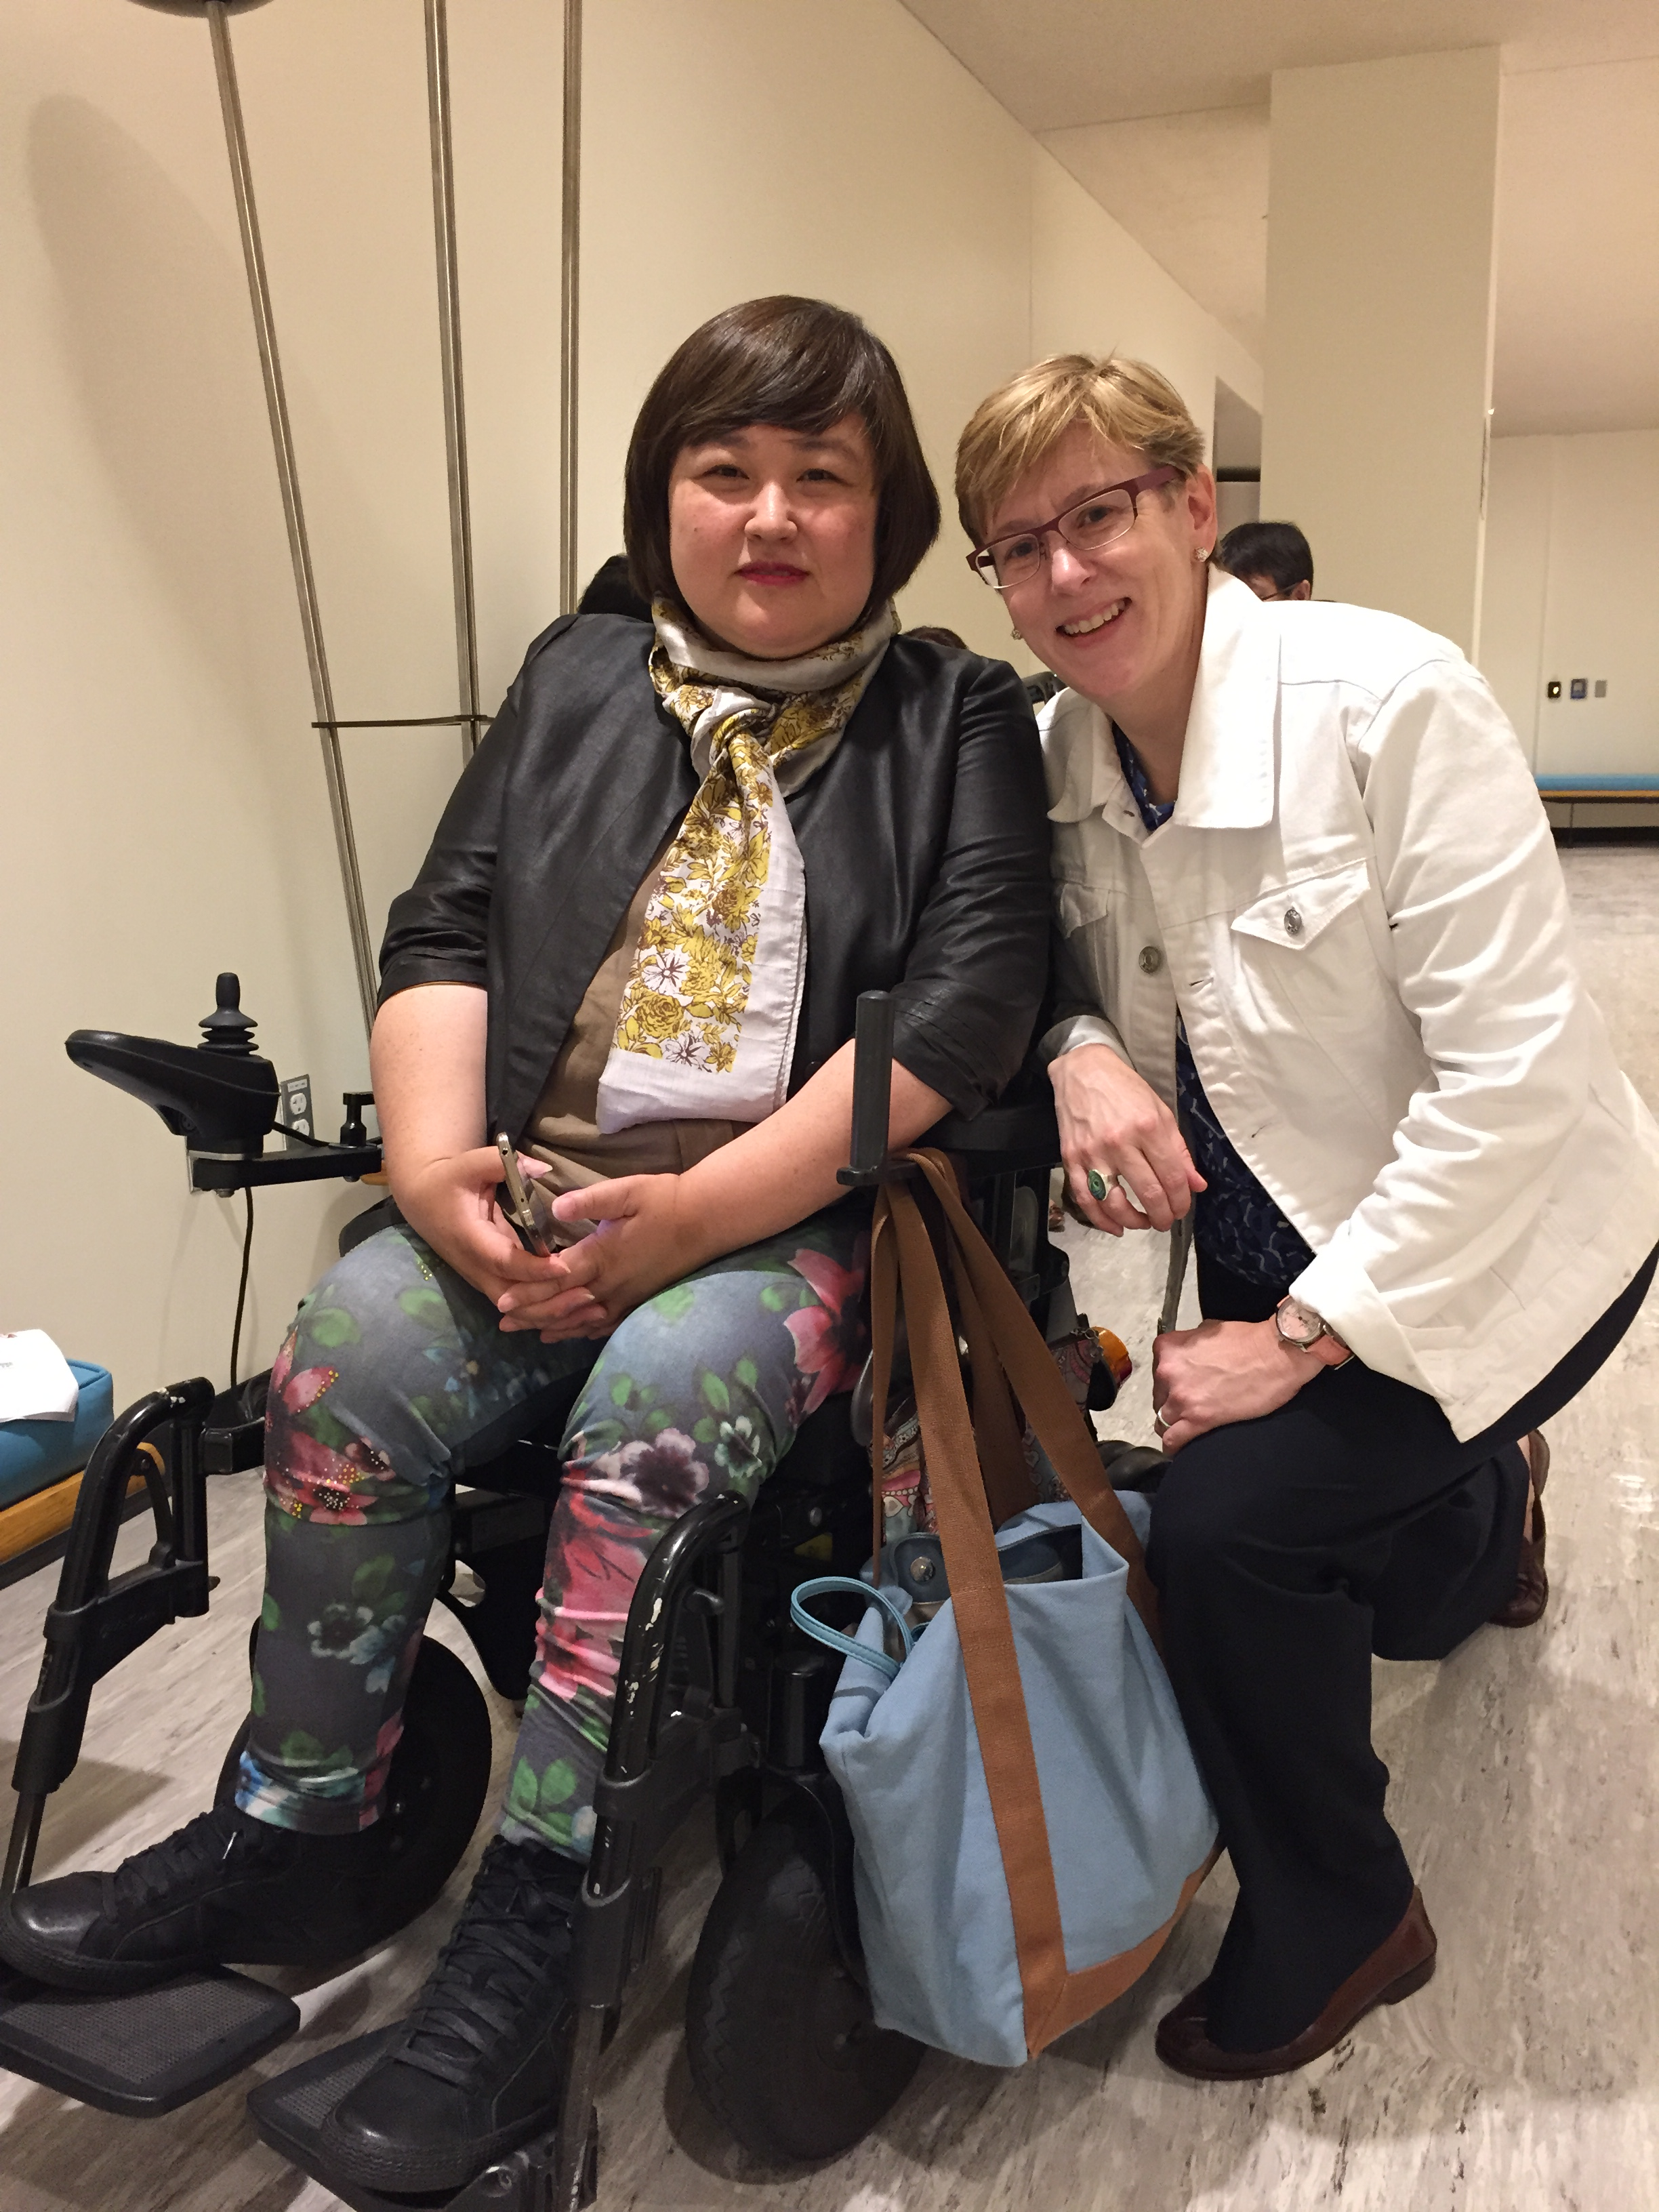
CRPD Committee Members: Chair & Vice Chair
Rosemary Kayess
Minjon Kim
18 members
Persons with diverse disabilities
Includes first person ever on a UN treaty body who is a person with an intellectual disability
Notes:
This slide shows two photos, one of the current Chair of the CPRD Committee, Rosemary Kayess, in the hall of the US Permanent Mission to the UN in New York, with USICD Board Member Janet Lord and the other the CRPD Committee Vice Chair, Minjon Kim, with Janet Lord.

Slide 12


Article 35 Reporting Requirement
State MUST report to
CRPD Committee receives report
CRPD Committee reviews report
Notes:
Article 32 of the CRPD lays of the reporting requirement and obligation.

Slide 13
What do States report on to the CRPD Committee?
13
(1) General obligations of States
Article 4: States must ensure that their legal framework is consistent with the CRPD – this may require a range of measures such as law reform, policy measures, budgeting, among others.
Article 5: Non-discrimination and equality must be reflected in the domestic law framework - non-discrimination also requires that reasonable accommodation be provided where needed to an individual with a disability. ALL rights in the CRPD must be respected without discrimination on the basis of disability
(2) Specific obligations of States under the CRPD
For example, the specific human rights obligations set out in Articles 10-30 (from the right to life to the right to participate in sport and culture)
(3) Other obligations, including data and statistics (Art. 31), international cooperation (Art. 32), monitoring obligations (Art. 33) among others.
Notes:
This slide sets out some of the general obligations of the CRPD:
Article 4: States must ensure that their legal framework is consistent with the CRPD – this may require a range of measures such as law reform, policy measures, budgeting, among others.
Article 5: Non-discrimination and equality must be reflected in the domestic law framework - non-discrimination also requires that reasonable accommodation be provided where needed to an individual with a disability. ALL rights in the CRPD must be respected without discrimination on the basis of disability
Article 4: States must ensure that their legal framework is consistent with the CRPD – this may require a range of measures such as law reform, policy measures, budgeting, among others.
Article 5: Non-discrimination and equality must be reflected in the domestic law framework - non-discrimination also requires that reasonable accommodation be provided where needed to an individual with a disability. ALL rights in the CRPD must be respected without discrimination on the basis of disability

Slide 14
How are OPDs supported in the reporting process?
14
OPDs are often supported in their engagement with the CRPD reporting process through international cooperation. Donors often support this work.
The International Disability Alliance (IDA) office in Geneva is available to help and can participate in Interactive Dialogue if local OPDs cannot attend the session in Geneva.
Notes:
OPDs can receive support in their engagement with the reporting process.

Slide 15
The Reporting Cycle –
Step-by-Step
Notes:
This next set of slides examines the reporting process, step by step.

Slide 16
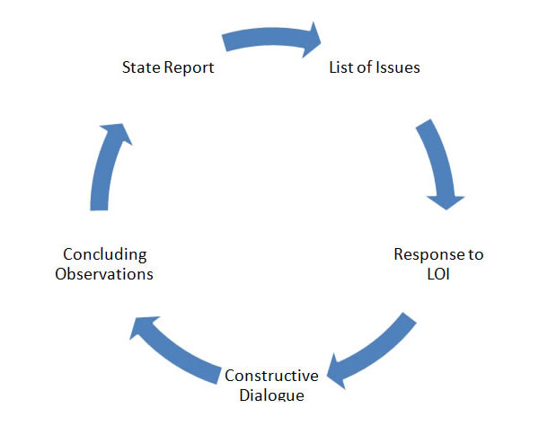
Cycle of Reporting
Notes:
Reporting is, of course, a cycle. This slide lists the cycle.

Slide 17
Step 1 – Reporting Cycle Begins
Preparation of initial report two (2) years after ratification
  The State Party should have consultations with civil society, including representative organizations of persons with disabilities, to prepare its State report (Art. 33(3).
17
Notes:
The first Step in the reporting process begins when a State ratifies the treaty. This triggers the reporting obligation and starts the cycle.

Slide 18


Step 2 – Submission of Reports to Committee in Parallel
1. State Party submits its State report to the CRPD Committee Opportunity for input from UN system, NHRIs, NGOs and OPDs
2. OPDs submit their own parallel or shadow reports to CRPD Committee with priority issues and concrete recommendations.
Notes:
Step 2 involves the submission of the State’s report to the CRPD Committee. This is an important step not only for the CRPD Committee which commences it review of the State report but also for OPDs who are then in a strong position to organize and start developing their own “shadow” or “parallel” report.

Slide 19
Step 3 – List of Issues
The CRPD Committee presents State Party with list of issues and questions based on concerns raised by the report.
OPDs can suggest issues for the list of issues and questions the Committee should ask the State, before the Committee adopts its list of issues.
Notes:
Step 3 happens after a State Party has submitted its report but before the CRPD Committee meets with the State in Geneva. At this stage. A List of Issues is generated to the State to gather more information, address gaps in the report, or otherwise allow the Committee to seek additional information from the State Party. OPDs may also play a role in this process, inviting the Committee to direct certain questions and requests for information to the State.

Slide 20
Step 4 – Written Replies to List of Issues
State Party submits written replies to list of issues and questions.
OPDs may also give their own responses to list of issues. This can assist Committee in its questioning of the State during the interactive dialogue.
20
Notes:
Step 4 provides the State Party with the chance to submit a written reply to the CPRD Committee responding to its List of Issues.

Slide 21
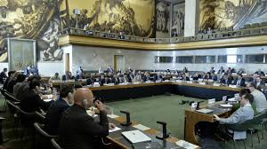
Step 5 – Interactive Dialogue between State & Committee in Geneva
Constructive face-to-face “interactive” dialogue between the Committee and the State Party delegation.
OPDs can request in advance to give an oral presentation during the session in which the constructive dialogue with their country will take place.
Before the dialogue, and during the same session, OPDs may try to meet with Committee members, especially the country Rapporteur, to identify priority issues and recommendations.
Opportunity for input from UN system, NHRIs, NGOs and OPDs.
21
Notes:
Step 5 is the face-to-face “Interactive Dialogue” between the State Party and the CRPD Committee.

Slide 22
Step 6 – Concluding Observations
The CRPD Committee issues its concluding observations on the report, including recommendations.
  - Before the concluding observations are adopted, OPDs can identify for the Committee members the priority areas that need quick action, and suggest concrete recommendations on the issues that were raised during the dialogue.
  - Concluding observations should be circulated widely at national level.
22
Notes:
Step 6 in the reporting process is the issuance by the CRPD Committee of concluding observations and recommendations to the reporting State Party. OPDs that have participated actively in the reporting process will have the chance to see whether their advocacy efforts paid off – in other words they can assess to what extent the CRPD Committee may have taken up their suggestions regarding recommendations.

Slide 23
Step 7 – Follow-Up Procedures
Procedures to follow up on implementation of CRPD Committee's recommendations.
  - Opportunity for input from UN system, NHRIs, NGOs and OPDs.
  OPDs should work with the national monitoring mechanism and the government on implementing recommendations and follow up.
OPDs should do their own monitoring for the next report.
Notes:
Step 7 concerns Follow-up procedures – it allows the CRPD Committee to follow up and assess to what extent recommendations where actually implemented by the reporting State Party. OPDs have their own role to play in following up.

Slide 24
OPD Advocacy Planning for Reporting - Key Steps
Formation of coalition/reporting team
Creation of reporting advocacy plan and timeline
Allocation of responsibilities for each task
Research and information gathering
Report development
Consultations and engagement with stakeholders & partners
Submission of report to CRPD Committee (and other stakeholders)
Advocacy to support concluding observations and recommendations of CRPD Committee
National level follow-up – checking in with gov’t about implementation of recommendations
Continued dissemination of report to other actors (e.g. Special Rapporteur, National Human Rights Commission, etc)
Notes:
This slide suggests some important stages in OPD advocacy relating to the CRPD Committee reporting process.

Slide 25
Format & Structuring of the Shadow Report
CRPD Committee Guidelines on the Participation of Disabled Persons Organizations & Civil Society Organizations in the Work of the Committee (2014)
Length concrete and concise documents, Maximum of 10,700 words in the case of alternative reports to the State Party reports; Maximum of 5,350 words other submissions.
Structure & Format Identification of the submitting organization, brief description of its activities at international and/or national level, their mission/vision statement, role persons with disabilities play in the organisation, and level of inclusiveness and participation of persons with disabilities in the drafting of the submission. Executive summary, no longer than one page. Reference to specific articles of the Convention addressed in the submission. Recommendations.
25
Notes:
The CRPD Committee has set out guidelines on the participation of organizations of persons with disabilities and civil society in its reporting process. These should be reviewed carefully by OPDs wishing to participate in any aspect of the reporting process.

Slide 26

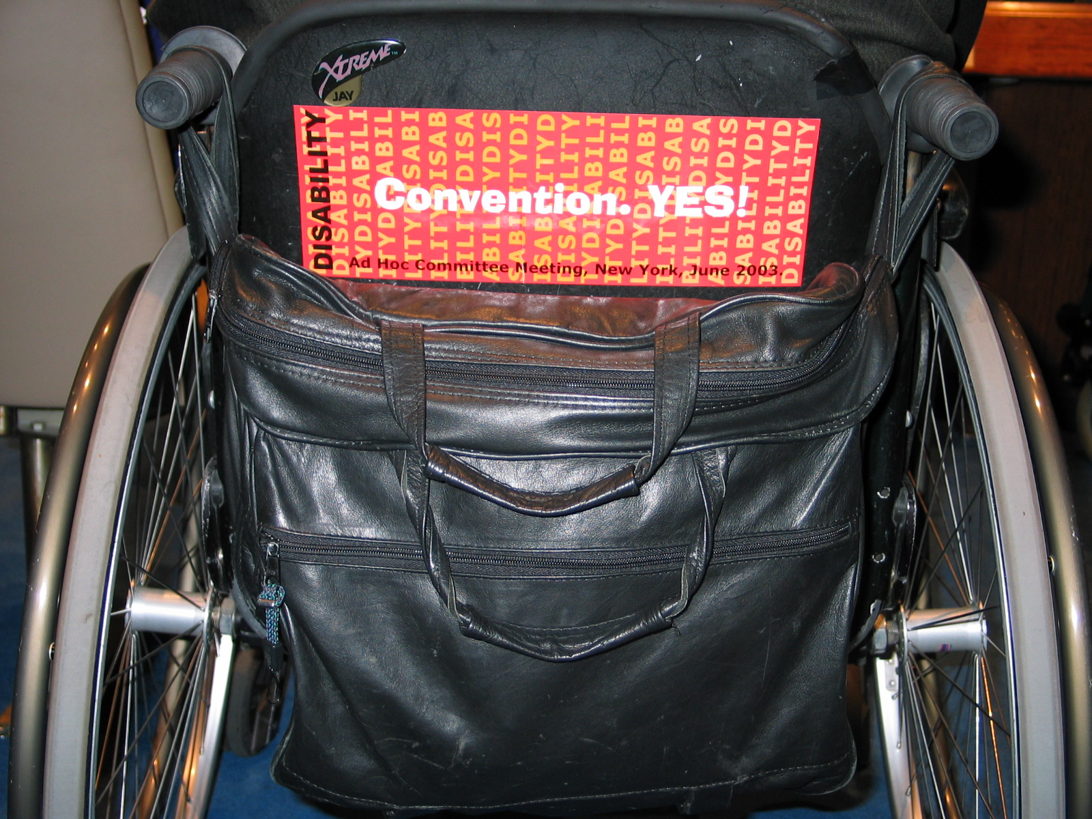
Resources:
Human Rights. YES! Action and advocacy on the rights of persons with disabilities, Part 3 (2d ed., 2012).
Committee on the Rights of Persons with Disabilities web page
Office of the High Commissioner for Human Rights, “Monitoring the Convention on the Rights of Persons with Disability: Guidance for Human Rights Monitors”
Notes:
There are many helpful resources on the CRPD Committee’s reporting process. Some of these are listed on the slide with links.

